Slide 1
Entrepreneurship
Notes:
All businesses, regardless of their size, location, or mission, operate within a larger external environment. This external environment consists of everything outside an organization’s boundaries that might affect it. The external environment plays a major role in determining the success or failure of any organization.

Slide 2
Canada’s Small Businesses
Small business defined as < 50 employees – sector called SME (small-medium enterprises)
Micro-businesses are nicknamed “Mom and Pop”, as many are family-run
Of all businesses in Canada, 98% are small (Royal Bank)
2.7 million Canadians are self-employed
48% of Canadians working in business, work for SMEs
78% of businesses produce services (e.g., retail store), not goods (e.g., manufacturing)
Source: Statistics Canada, 2004
4-<number>
Notes:
These trends led to the growth of new businesses such as LinkedIn. Businesses understanding and taking advantage of trends (not fads) will likely be more successful.

Slide 3
Canada’s Small Businesses 2
45% of Canada’s GDP comes from SMEs (estimate of CFIB)
Largest sector of SMEs is retail – 130,000 businesses, next is personal services 125,000, next is construction 115,000 businesses (Royal Bank)
Business survival rate after 7 years is only 31%
86% of small businesses are exporters (sell products or services to other countries) Statistics Canada, 2004
Self-employment rising fastest in youth (15-24) and older (>55 years) Tal, CIBC, 2006
4-<number>
Notes:
These trends led to the growth of new businesses such as LinkedIn. Businesses understanding and taking advantage of trends (not fads) will likely be more successful.

Slide 4
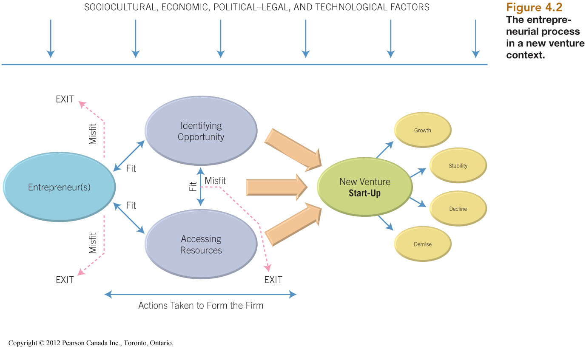
ENTREPRENEURIAL PROCESS
Ebert et al, Pearson Canada, 2012
Notes:
For entrepreneurs to be successful, there must be a “fit” between the entrepreneur and the opportunity (e.g., does the entrepreneur have the skills to understand the opportunity), and between the entrepreneur and resources (e.g., can financial and human resources needed be accessed). The two most common reasons new start-ups fail are: lack of business management skills in the entrepreneur and lack of financial resources (i.e., not enough cash invested).
From the diagram it is obvious that the business environment has a significant impact on the success of a business. For example, a business offering a high-priced luxury product may not be successful if started when the economic climate is trending down.

Slide 5
Trends from Past Decade
Online presence – at least web-site, now increasing using social media (e.g. Twitter, Facebook)
Greening products & services – reducing packaging, eco-friendly
Focusing on customers to differentiate – big box stores makes impossible to compete on price
Kiosks & mini-stores – bank within grocery store, leasing space to others, etc.
Some businesses getting smaller – no storefront anymore due to improved technology
  (Source: Ward)ut.com)
4-<number>
Notes:
These trends led to the growth of new businesses such as LinkedIn. Businesses understanding and taking advantage of trends (not fads) will likely be more successful.

Slide 6
Trends for Next Decade
More senior entrepreneurs
Greater desire for customization by consumers
More globalization
Greater use of Internet
More immigrants – more likely to be in business
Greater partnerships / cooperation amongst businesses
More virtual businesses
Greater speed in responding to customers
( Source: Tal, CIBC World Markets, 2006 : Tal, CIBC World
Notes:
These are trends for the next group of business start-ups. This shows excellent opportunities for unique businesses locally built that can offer unique services worldwide.

Slide 7
Identifying Opportunities
Generating ideas
Screening ideas
Developing the opportunity
Notes:
8
8
These are the three step is identifying opportunities that could become future businesses. Based on environmental scanning, knowledge of customers, and understanding customer “pain” (needs to be met), an entrepreneur will develop ideas. Those ideas will be screened against entrepreneurial skills, resources available, competitive environment, etc. Ideas that meet the screening criteria may proceed to becoming opportunities. The process is:
Identify a customer’s “pain” – needs to be met
Generate ideas to address the needs
Assess or screen those ideas to determine ideas that have merit
Develop the idea into a business opportunity
Create a product or service from the opportunity

Slide 8
Source of Ideas
300 entrepreneurs asked where get ideas from:
Singh, Hills, and Lumpkin, 1999
Source or Idea | % of responses
Prior Business Experience | 73.0%
Business Associates | 32.8%
Saw a Similar Business Somewhere Else | 25.8%
Suggestion by Friends or Relatives | 19.1%
Hobby/Personal Interest | 17.2%
Personal Research | 11.3%
It Just Came to Mind | 10.9%
Saw Something in a Magazine / Newspaper | 2.3%
Saw or Heard Something on Radio / TV | 0.4%
Other Sources | 4.7%
4-<number>
Notes:
This slide shows that ideas are rarely just discovered by an idea (only 10.9% just came to mind). Most ideas come from knowing the customer and the customer’s needs (73% from prior experience in the industry).

Slide 9
Ideas
Bette Naismith Graham – secretary thought how to copy artists’ fixes of mistakes, by “painting” over in same colour. Led to Liquid Paper, sold to Gillette in 1979 for $47.5 million
Spencer Silver – at 3M, developed glue that didn’t hold well. Four years later, Arthur Fry glued edge of piece of paper so it wouldn’t fall out or damage his book. Led to Post-it-Notes – now major product for 3M
Fred Smith – unable to get parts delivered for his aircraft sales co. – delivered packages on timely basis – FedEx
Jerry Yang and David Filo – no way to organize favourite web-sites, created on-line directories to find and store favourites – Yahoo!
4-<number>
Notes:
Here are some ideas that became opportunities, and later developed into products.

Slide 10
PEST Opportunities
Trend | Opportunity | Product
Teens with more cash | Designer clothes, MP3 | GAP, MTV
Interest in stock market | Online brokerages | Buyandhold.com
Dual income, no time | Take-out food, quick meals | Domino’s, Stouffer’s
Health interest | Fitness clubs, weight-loss | Curves, GNC Nutrition
More mobile population | Cell phones, laptops | RIM, Nokia, Dell
Internet development | E-commerce, etc. | eBay, Google
Advances in biotech | Food, pharmaceuticals | Genentech, BioInform
New safety standards | Consulting firms, compliance | Compliance Consulting
4-<number>
Notes:
PEST (Political, Economic, Social, and Technology) analysis is part of environmental scanning. Here are some opportunities that have addressed trends, and later developed into products.

Slide 11
4 Qualities of An Opportunity
Attractive
Timely
Opportunity
Fixed to product or value-adding biz
Durable
*Opportunity still doesn’t work if no “window of opportunity” – speed to market important
Ebert et al, Pearson Canada , 2012
4-<number>
Notes:
What makes a good opportunity? It should be attractive – there are lots of people that have the need. It should be timely – the market is ready for the product. It should be durable – the opportunity responds to an ongoing need, and not a fad. It should be value-adding – does the opportunity allow for a competitive advantage, proprietary advantage, or differentiation from competitors, and is it difficult for others to copy.

Slide 12
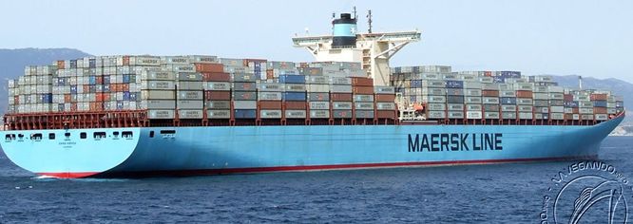
Emma Maersk
One of largest ships in world - 400 m. long
15000 TEUs (2 TEUs = 53’ container)
Burns 150,000 litres (40,000 gallons) of fuel / day
How could you save 35,000 litres / day?
4-<number>
Notes:
www.kiteship.com

Slide 13
Less activity in kids
Increased screen-based activity has resulted in less
activity in children, spawning health problems.
It is suggested that the current generation of children will be first in history to live shorter lives than parents.
Interesting activities are being sought to entice kids to leave computers and gaming.
Skateboards, etc. were trends (fads?)
What is next opportunity?
4-<number>
Notes:
Knoxcooter
http://www.youtube.com/watch?v=m-y5av-9wWw

Slide 14
Luxury activities increasing
Pampering is growing trend – partly in response to growing stress of working people
Growth in spa-related activities and more group activities emerging
Health and fitness travel emerging
Increase in different ways to explore cities
What is the next opportunity?
4-<number>
Notes:
www.hottubboats.com

Slide 15
3 Ways to Identify Opportunities
Observing trends
  PEST trends – e.g., deregulation led to WestJet
  Aging boomers led to condos, now retirement places
Solving problem(s)
  Lack of online security led to www.SmartSwipe.ca
  Rising energy prices www.kiteship.com
  Self-propulsion led to KnoXscooter
      http://www.youtube.com/watch?v=m-y5av-9wWw
Finding gaps in marketplace (not served by others)
  Yoga clothing – Lululemon
  www.hottubboats.com
4-<number>
Notes:
To identify opportunities, an entrepreneur would look at trends, see how the opportunity addresses a customer’s pain – a problem he/she is having, and is not being addressed by competitors in the market now.

